Slide 1
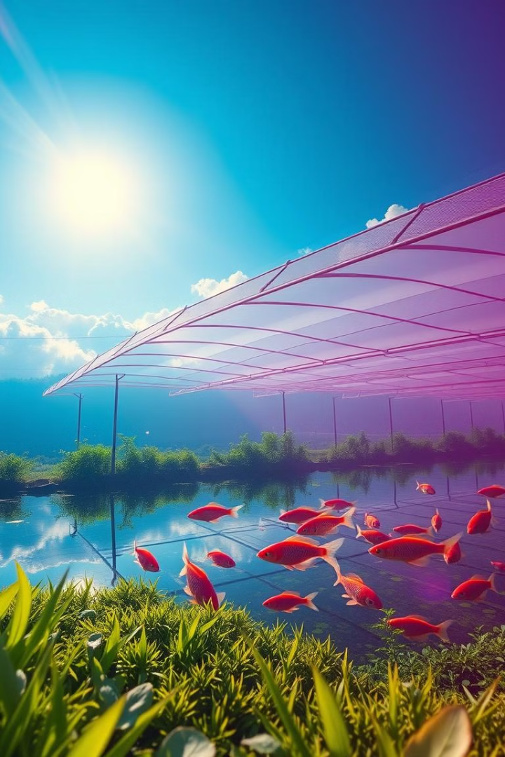
Sustainable Fish Farming
Welcome! We are passionate about sustainable food production. Our innovative fish farming solution is changing the way we consume seafood.
EM
by Ebenezer Musa

Slide 2
The Global Seafood Demand Challenge
Global demand for seafood is outpacing supply, putting immense pressure on wild fish populations. This unsustainable fishing is depleting ocean resources.
Overfishing
Pollution
Climate Change
Unsustainable fishing practices are depleting wild fish populations at alarming rates. This disrupts marine ecosystems and threatens food security.
Pollution from industrial activities and agricultural runoff contaminates waterways, harming fish and threatening the health of our oceans.
Rising ocean temperatures and acidification are impacting marine life, altering habitats, and threatening the survival of various fish species.

Slide 3
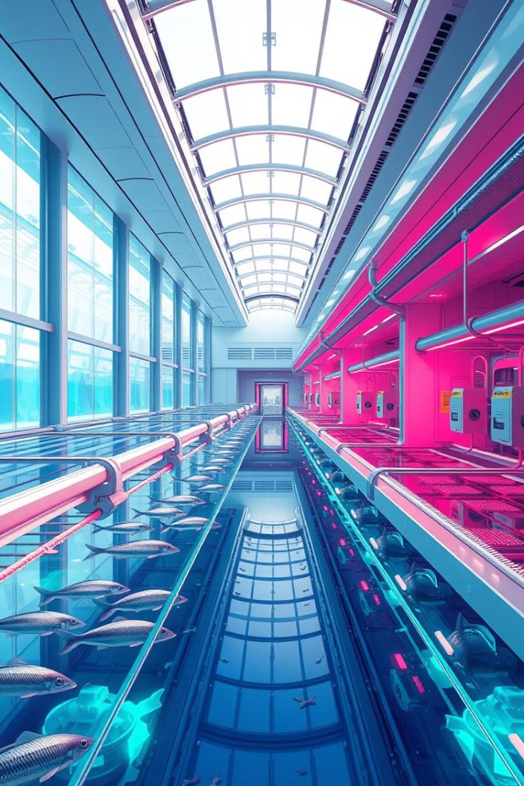
Revolutionizing Fish Farming
Our solution is a closed-loop, recirculating aquaculture system that utilizes cutting-edge technology for sustainable and efficient fish production.
1
Precision Control
2
Minimal Water Usage
Our system allows for precise control over water quality, temperature, and feeding, ensuring optimal conditions for fish growth and health.
Recirculating water systems minimize water usage and reduce the environmental impact associated with traditional fish farming practices.
3
Reduced Waste
4
High Productivity
Our closed-loop system effectively captures and treats fish waste, minimizing pollution and promoting a cleaner environment.
By optimizing fish growth conditions, we achieve significantly higher yields compared to traditional fish farming methods, boosting efficiency and sustainability.

Slide 4

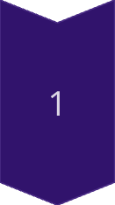
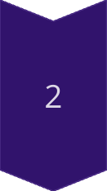
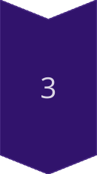
Market Opportunity
The global demand for seafood continues to rise, fueled by growing populations and increasing awareness of the health benefits of fish.
Growing Consumer Demand
Consumers are increasingly seeking sustainably sourced seafood and are willing to pay a premium for products that meet ethical and environmental standards.
Retail and Restaurant Expansion
Supermarkets and restaurants are expanding their offerings of sustainably farmed fish, catering to the growing demand for responsible seafood choices.
Government Regulations
Governments around the world are enacting regulations to promote sustainable fishing practices and support responsible aquaculture development.

Slide 5

Competitive Advantage
Our technology provides a significant advantage over traditional fish farming methods, offering higher yields, reduced environmental impact, and improved fish welfare.
Sustainability
Closed-loop system, minimal water usage, reduced waste
Efficiency
Precision control, optimized growth conditions, high yields
Scalability
Modular design, adaptable to various locations and sizes
Innovation
Continuous research and development, advanced technology integration

Slide 6
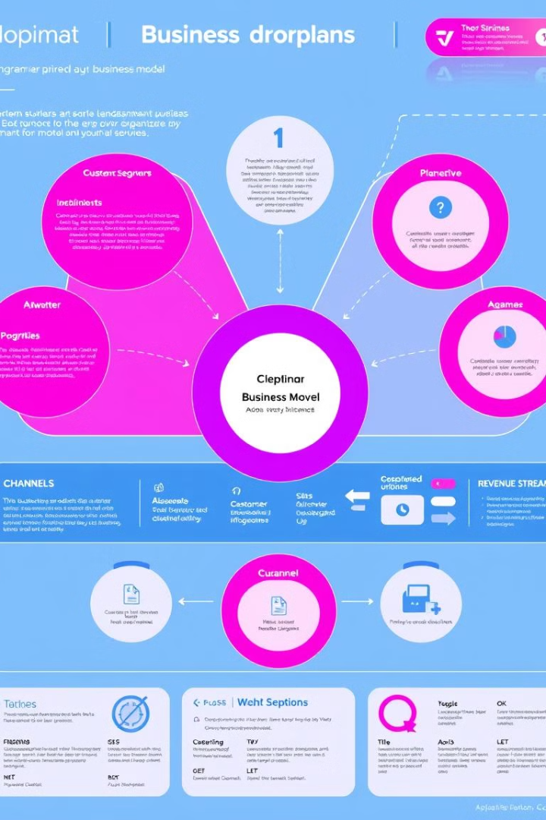
Business Model
Our business model is focused on producing high-quality, sustainably farmed fish and distributing them to retail and restaurant customers.
Fish Production
Distribution
Our core business is the production of sustainably farmed fish using our innovative recirculating aquaculture system.
We distribute our fish to a network of retail stores, restaurants, and foodservice providers, ensuring a consistent supply chain.
Direct Sales
We also offer direct sales to consumers through online platforms and farmers' markets, fostering a strong connection with our customers.

Slide 7
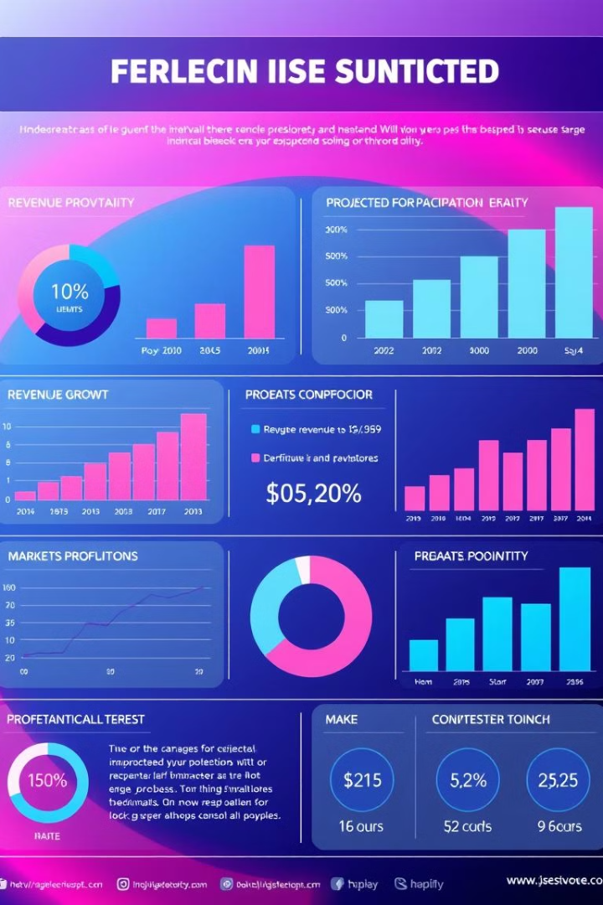



Financials and Projections
Our projections demonstrate a strong potential for growth and profitability based on the increasing demand for sustainably farmed seafood.
Market Growth
We project significant revenue growth driven by the increasing demand for sustainable seafood.
Profitability
Our efficient operations and cost-effective production methods will lead to strong profitability.
Investment Opportunities
We are seeking investment to scale our operations and expand our market reach.

Slide 8

The Team
Our team comprises experienced professionals with expertise in aquaculture, technology, and business development, all driven by a shared passion for sustainable seafood.
1
Emmanuel Musa
Emmanuel is a renowned aquaculture expert with extensive experience in developing sustainable fish farming practices.
2
Bomi Adewole
Bomi is a seasoned engineer with a proven track record in designing and implementing innovative aquaculture systems.
3
Caleb Odey
Caleb is a highly skilled business development professional with a deep understanding of the seafood industry.

